Slide 1
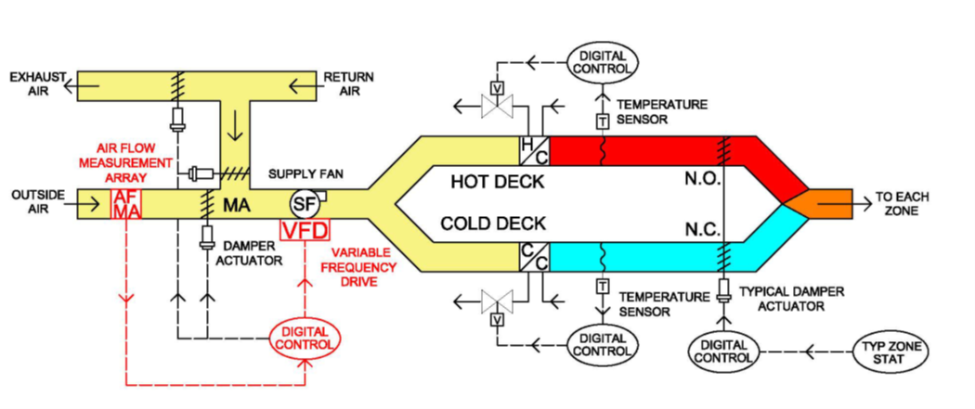
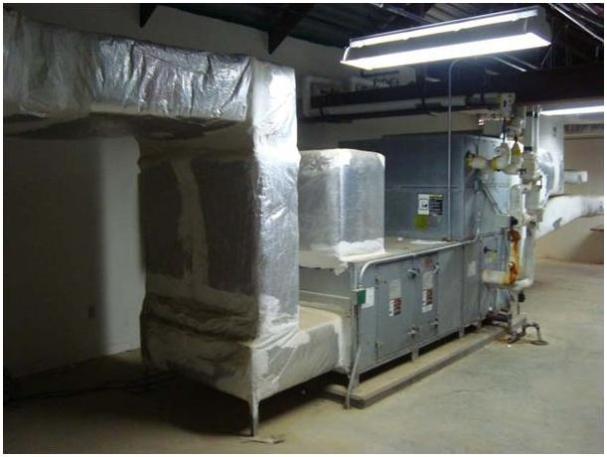
Multizone to Variable Volume HVAC Controls Retrofit for Energy Efficiency
ERDC-CERL developed a controls retrofit for older multizone HVAC Units.
Involves adding 2 pieces of equipment
    a variable speed drive on the fan
    an air flow instrument
  …and modifying the controls program to turn the system down when not needed.
Field tests showed 24-60% savings in energy at the air handler.
  An optional demand control feature adds ~5% more savings.
Does not require vacating the building to install.
Cost ~ $22K. SPB ~ 3-5yrs, depending on local scope and costs. - VS - $500K⁺ and SPB=NA
A great “add on” effort to a controls upgrade project or retrocommissioning effort. Incremental costs ~$10K.
A suite of tools streamline the implementation effort.
  Technical Evaluation Resources – fact sheet, tech note, on-demand training.
  Field Scoping Guide
  Savings Estimator spreadsheet
  Procurement support (Design guide, Templates: Performance Work Statement, Drawings, Specifications, Sequences of Operation)
  Commissioning Guide
Retrofit allows accumulating energy and cost savings now while delaying costly full system change out.
Good interim solution for meeting energy reduction targets with limited budgets
Next Steps: Review fact sheet & other tools, talk w/ techs, perform scoping/feasibility analysis
Notes:
The Corps of Engineers Construction Engineering Research Lab, CER,L has developed a controls retrofit for older multizone HVAC units. We have [some/several] of these types of units and they can be real energy hogs.
The retrofit is relatively simple and has a potentially big pay off.
It involves adding 2 pieces of equipment (a variable speed drive on the fan, and air flow instrument and modifying the controls program to turn the system down when not needed.
Field tests showed 24-60% savings in energy. An optional demand control ventilation (DCV) feature adds about 5% more savings. DCV requires adding sensors in rooms.
A key feature of the retrofit is that it does NOT require vacating the building to install.
It costs about $22K/unit (if starting a new project). The Simple Pay Back (SPB) varies between 3-5yrs, depending on local models and costs. This is a fraction of the cost of a system change out that costs over a half a million and never pays back installation costs with energy savings.
It’s a great add on effort to a controls upgrade project because marginal costs are only about $10K. It could be a viable part of a retrocommissioning effort.
A suite of available tools streamline the implementation effort and include technical evaluation documents, a scoping guide, a savings estimator spreadsheet, procurement support templates, and a commissioning guide.
This seems like it is worth exploring.
The retrofit allows accumulating energy and cost savings now (with retained saving authority) while delaying costly full system change out. (for about 10yrs)
It may be a good interim solution for meeting energy reduction targets with limited budgets
The next steps would be to review the tools, talk with the technicians, and perform a scoping/feasibility analysis to see if it makes sense for us.

